Slide 1

Slides for Chapter 6:
Indirect Communication
From Coulouris, Dollimore, Kindberg and Blair
Distributed Systems:
Concepts and Design
Edition 5, © Addison-Wesley 2012

Slide 2
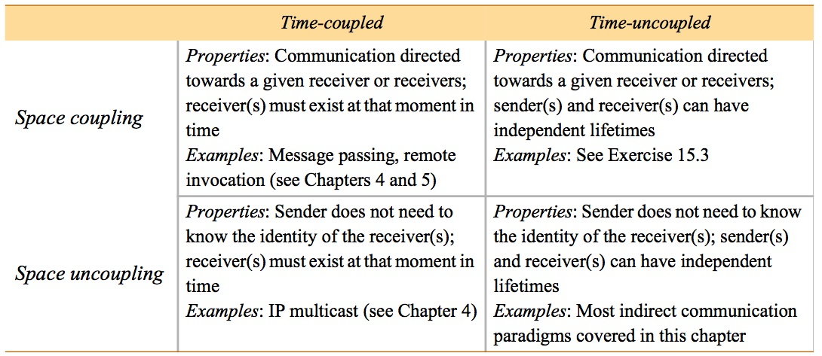
Figure 6.1
Space and time coupling in distributed systems
Instructor’s Guide for Coulouris, Dollimore, Kindberg and Blair, Distributed Systems: Concepts and Design Edn. 5
© Pearson Education 2012

Slide 3
Figure 6.2
Open and closed groups
Instructor’s Guide for Coulouris, Dollimore and Kindberg Distributed Systems: Concepts and Design Edn. 4
© Pearson Education 2005

Slide 4
Figure 6.3
The role of group membership management
Group
address
expansion
Group
Leave
send
Multicast
Group membership
communication
Fail
management
Join
Process group
Instructor’s Guide for Coulouris, Dollimore, Kindberg and Blair, Distributed Systems: Concepts and Design Edn. 5
© Pearson Education 2012

Slide 5
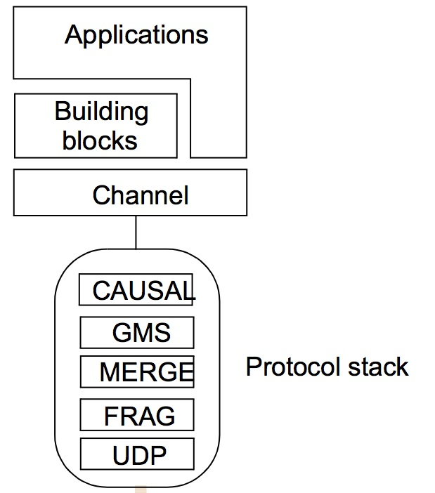
Figure 6.4
The architecture of JGroups
Instructor’s Guide for Coulouris, Dollimore, Kindberg and Blair, Distributed Systems: Concepts and Design Edn. 5
© Pearson Education 2012

Slide 6
Figure 6.5
Java class FireAlarmJG
import org.jgroups.JChannel;
public class FireAlarmJG {
public void raise() {
  try {
    JChannel channel = new JChannel();
    channel.connect("AlarmChannel");
    Message msg = new Message(null, null, "Fire!"); channel.send(msg);
  }
  catch(Exception e) {
}
}
Instructor’s Guide for Coulouris, Dollimore, Kindberg and Blair, Distributed Systems: Concepts and Design Edn. 5
© Pearson Education 2012

Slide 7
Figure 6.6
Java class FireAlarmConsumerJG
import org.jgroups.JChannel;
      public class FireAlarmConsumerJG {
        public String await() {
try {
JChannel channel = new JChannel();
channel.connect("AlarmChannel");
Message msg = (Message) channel.receive(0);
return (String) msg.GetObject();
} catch(Exception e) {
return null;
}
}
}
Instructor’s Guide for Coulouris, Dollimore, Kindberg and Blair, Distributed Systems: Concepts and Design Edn. 5
© Pearson Education 2012

Slide 8
Figure 6.7
Dealing room system
Dealer’s computer
External
Dealer’s computer
source
Dealer
Notification
Notification
Dealer
Notification
Information
provider
Notification
Notification
Notification
Notification
Dealer’s computer
Dealer’s computer
Notification
Information
provider
Notification
Dealer
Notification
Dealer
External
source
Instructor’s Guide for Coulouris, Dollimore and Kindberg Distributed Systems: Concepts and Design Edn. 4
© Pearson Education 2005

Slide 9
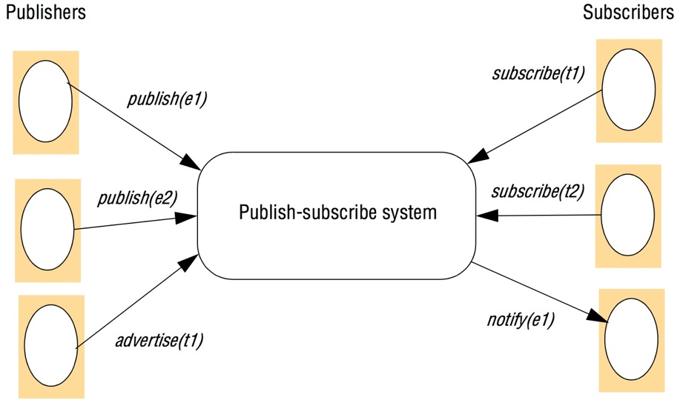
Figure 6.8
The publish-subscribe paradigm
Instructor’s Guide for Coulouris, Dollimore and Kindberg Distributed Systems: Concepts and Design Edn. 4
© Pearson Education 2005

Slide 10
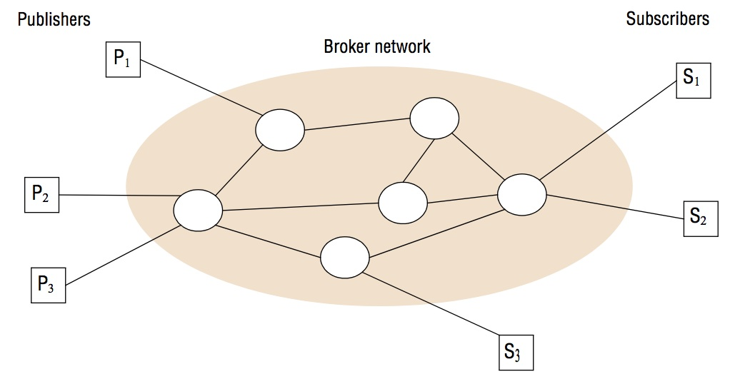
Figure 6.9
A network of brokers
Instructor’s Guide for Coulouris, Dollimore and Kindberg Distributed Systems: Concepts and Design Edn. 4
© Pearson Education 2005

Slide 11
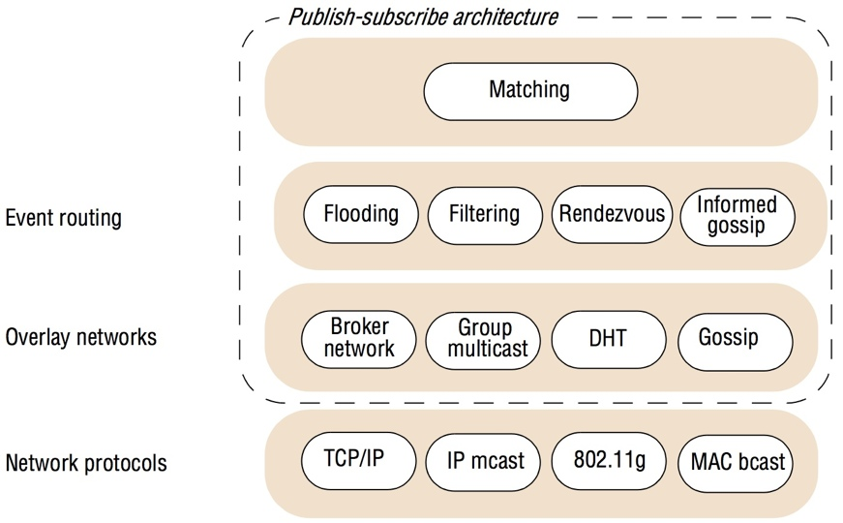
Figure 6.10
The architecture of publish-subscribe systems
Instructor’s Guide for Coulouris, Dollimore and Kindberg Distributed Systems: Concepts and Design Edn. 4
© Pearson Education 2005

Slide 12
Figure 6.11
Filtering-based routing
upon receive publish(event e) from node x 1
matchlist := match(e, subscriptions) 2
  send notify(e) to matchlist; 3
    fwdlist := match(e, routing); 4
      send publish(e) to fwdlist - x; 5
upon receive subscribe(subscription s) from node x 6
if x is client then 7
  add x to subscriptions; 8
    else add(x, s) to routing; 9
      send subscribe(s) to neighbours - x; 10
Instructor’s Guide for Coulouris, Dollimore and Kindberg Distributed Systems: Concepts and Design Edn. 4
© Pearson Education 2005

Slide 13
Figure 6.12
Rendezvous-based routing
upon receive publish(event e) from node x at node i
rvlist := EN(e);
if i in rvlist then begin
  matchlist :=match(e, subscriptions);
  send notify(e) to matchlist;
end
send publish(e) to rvlist - i;
upon receive subscribe(subscription s) from node x at node i
rvlist := SN(s);
if i in rvlist then
  add s to subscriptions;
else
  send subscribe(s) to rvlist - i;
Instructor’s Guide for Coulouris, Dollimore and Kindberg Distributed Systems: Concepts and Design Edn. 4
© Pearson Education 2005

Slide 14
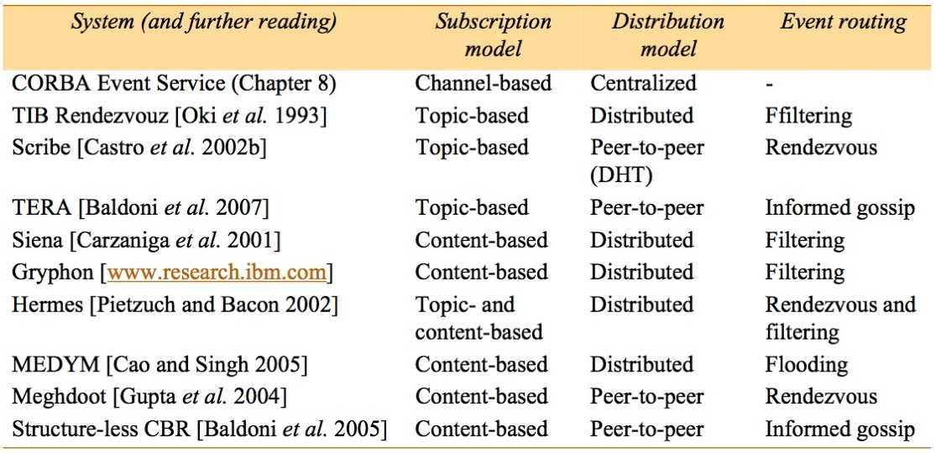
Figure 6.13
Example publish-subscribe system
Instructor’s Guide for Coulouris, Dollimore and Kindberg Distributed Systems: Concepts and Design Edn. 4
© Pearson Education 2005

Slide 15
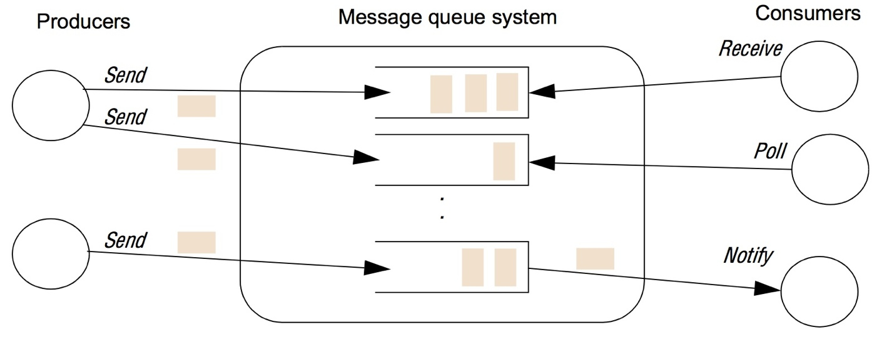
Figure 6.14
The message queue paradigm
Instructor’s Guide for Coulouris, Dollimore and Kindberg Distributed Systems: Concepts and Design Edn. 4
© Pearson Education 2005

Slide 16
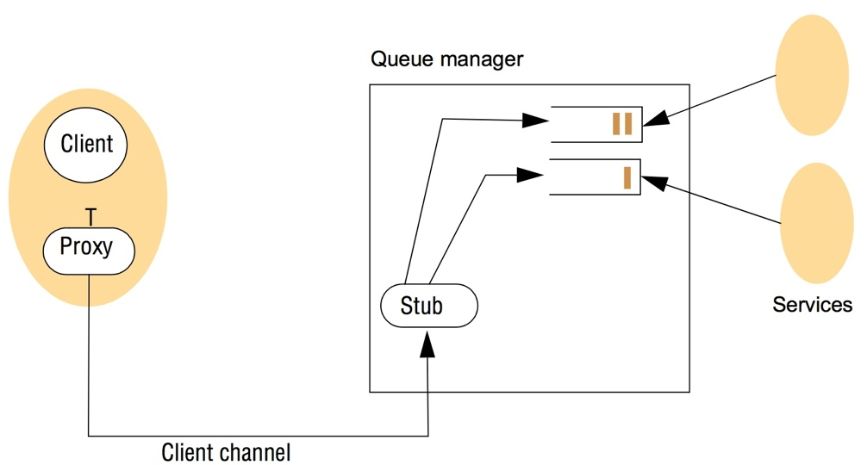
Figure 6.15
A simple networked topology in WebSphere MQ
Instructor’s Guide for Coulouris, Dollimore and Kindberg Distributed Systems: Concepts and Design Edn. 4
© Pearson Education 2005

Slide 17
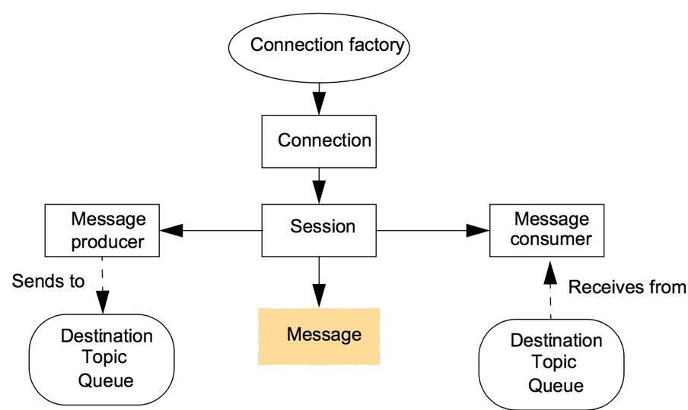
Figure 6.16
The programming model offered by JMS
Instructor’s Guide for Coulouris, Dollimore and Kindberg Distributed Systems: Concepts and Design Edn. 4
© Pearson Education 2005

Slide 18
Figure 6.17
Java class FireAlarmJMS
import javax.jms.*;
import javax.naming.*;
public class FireAlarmJMS {
public void raise() {
  try { 1
    Context ctx = new InitialContext(); 2
    TopicConnectionFactory topicFactory = 3
      (TopicConnectionFactory)ctx.lookup ("TopicConnectionFactory"); 4
      Topic topic = (Topic)ctx.lookup("Alarms"); 5
      TopicConnection topicConn = 6
        topicConnectionFactory.createTopicConnection(); 7
      TopicSession topicSess = topicConn.createTopicSession(false, 8
        Session.AUTO_ACKNOWLEDGE); 9
        TopicPublisher topicPub = topicSess.createPublisher(topic); 10;
    TextMessage msg = topicSess.createTextMessage(); 11
    msg.setText("Fire!"); 12
    topicPub.publish(message); 13
} catch (Exception e) { 14
} 15
}
Instructor’s Guide for Coulouris, Dollimore and Kindberg Distributed Systems: Concepts and Design Edn. 4
© Pearson Education 2005

Slide 19
Figure 6.18
Java class FireAlarmConsumerJMS
import javax.jms.*; import javax.naming.*;
public class FireAlarmConsumerJMS
public String await() {
try { 1
  Context ctx = new InitialContext(); 2
  TopicConnectionFactory topicFactory = 3
    (TopicConnectionFactory)ctx.lookup("TopicConnectionFactory"); 4
        Topic topic = (Topic)ctx.lookup("Alarms"); 5
  TopicConnection topicConn = 6
topicConnectionFactory.createTopicConnection(); 7
TopicSession topicSess = topicConn.createTopicSession(false, 8
Session.AUTO_ACKNOWLEDGE); 9
TopicSubscriber topicSub = topicSess.createSubscriber(topic); 10
topicSub.start(); 11
TextMessage msg = (TextMessage) topicSub.receive(); 12
return msg.getText(); 13
} catch (Exception e) { 14
return null; 15
}16
}
Instructor’s Guide for Coulouris, Dollimore and Kindberg Distributed Systems: Concepts and Design Edn. 4
© Pearson Education 2005

Slide 20
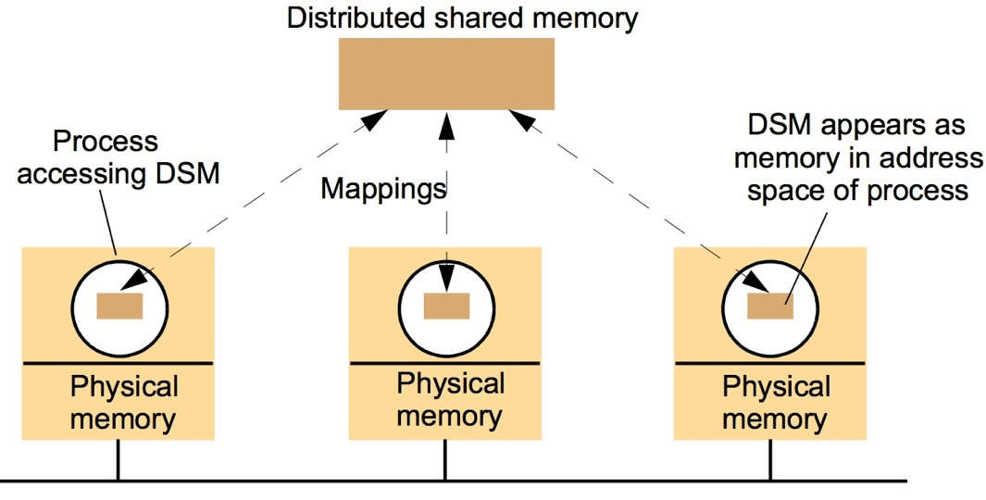
Figure 6.19
The distributed shared memory abstraction
Instructor’s Guide for Coulouris, Dollimore and Kindberg Distributed Systems: Concepts and Design Edn. 3
© Addison-Wesley Publishers 2000

Slide 21
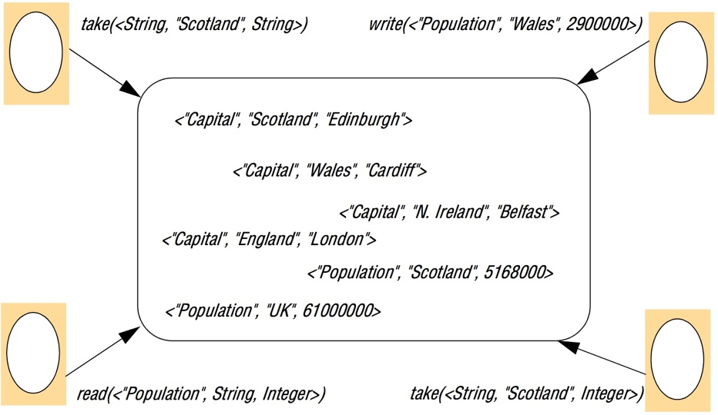
Figure 6.20
The tuple space abstraction
Instructor’s Guide for Coulouris, Dollimore and Kindberg Distributed Systems: Concepts and Design Edn. 4
© Pearson Education 2005

Slide 22
Figure 6.21 (1)
Replication and the tuple space operations [Xu and Liskov 1989]
write
1. The requesting site multicasts the write request to all members of the view; 2. On receiving this request, members insert the tuple into their replica and acknowledge this action;
3. Step 1 is repeated until all acknowledgements are received.
read
1. The requesting site multicasts the read request to all members of the view;
2. On receiving this request, a member returns a matching tuple to the requestor;
3. The requestor returns the first matching tuple received as the result of the operation (ignoring others); 4. Step 1 is repeated until at least one response is received.
continued on next slide
Instructor’s Guide for Coulouris, Dollimore and Kindberg Distributed Systems: Concepts and Design Edn. 4
© Pearson Education 2005

Slide 23
Figure 6.21 (continued)
Replication and the tuple space operations [Xu and Liskov 1989]
take Phase 1: Selecting the tuple to be removed
1. The requesting site multicasts the take request to all members of the view;
2. On receiving this request, each replica acquires a lock on the associated tuple set and, if the lock cannot
be acquired, the take request is rejected;
3. All accepting members reply with the set of all matching tuples;
4. Step 1 is repeated until all sites have accepted the request and responded with their set of tuples and the
intersection is non-null;
5. A particular tuple is selected as the result of the operation (selected randomly from the intersection of all
the replies);
6. If only a minority accept the request, this minority are asked to release their locks and phase 1 repeats.
Phase 2: Removing the selected tuple
1. The requesting site multicasts a remove request to all members of the view citing the tuple to be
removed;
2. On receiving this request, members remove the tuple from their replica, send an acknowledgement
and release the lock;
3. Step 1 is repeated until all acknowledgements are received.
Instructor’s Guide for Coulouris, Dollimore and Kindberg Distributed Systems: Concepts and Design Edn. 4
© Pearson Education 2005

Slide 24
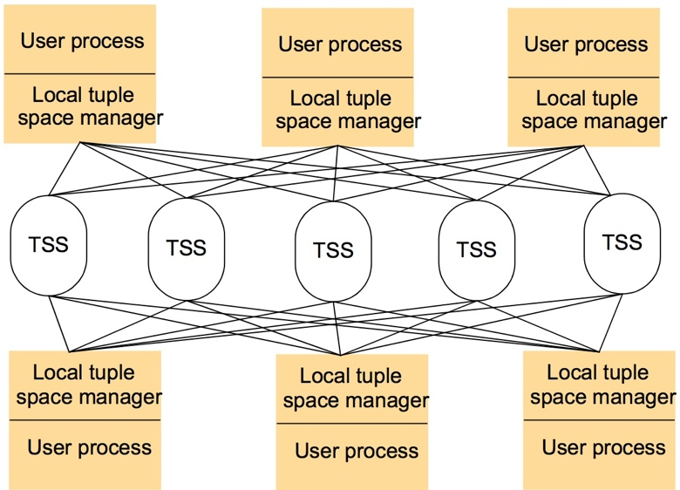
Figure 6.22
Partitioning in the York Linda Kernel
Instructor’s Guide for Coulouris, Dollimore and Kindberg Distributed Systems: Concepts and Design Edn. 4
© Pearson Education 2005

Slide 25
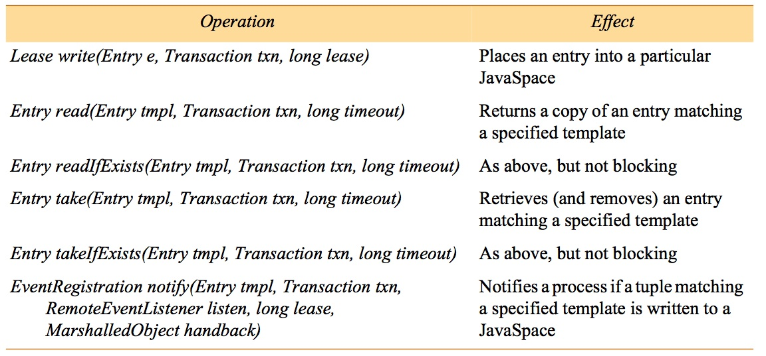
Figure 6.23
The JavaSpaces API
Instructor’s Guide for Coulouris, Dollimore and Kindberg Distributed Systems: Concepts and Design Edn. 4
© Pearson Education 2005

Slide 26
Figure 6.24
Java class AlarmTupleJS
import net.jini.core.entry.*;
public class AlarmTupleJS implements Entry {
public String alarmType;
public AlarmTupleJS() { }
}
public AlarmTupleJS(String alarmType) {
  this.alarmType = alarmType;}
}
}
Instructor’s Guide for Coulouris, Dollimore and Kindberg Distributed Systems: Concepts and Design Edn. 4
© Pearson Education 2005

Slide 27
Figure 6.25
Java class FireAlarmJS
import net.jini.space.JavaSpace;
public class FireAlarmJS {
public void raise() {
  try {
    JavaSpace space = SpaceAccessor.findSpace("AlarmSpace");
    AlarmTupleJS tuple = new AlarmTupleJS("Fire!");
    space.write(tuple, null, 60*60*1000);
catch (Exception e) {
}
}
}
Instructor’s Guide for Coulouris, Dollimore and Kindberg Distributed Systems: Concepts and Design Edn. 4
© Pearson Education 2005

Slide 28
Figure 16.26
Java class FireAlarmReceiverJS
import net.jini.space.JavaSpace;
public class FireAlarmConsumerJS {
public String await() {
  try {
  JavaSpace space = SpaceAccessor.findSpace();
AlarmTupleJS template = new AlarmTupleJS("Fire!");
AlarmTupleJS recvd = (AlarmTupleJS) space.read(template, null,
Long.MAX_VALUE);
return recvd.alarmType;
  }
  catch (Exception e) {
  return null;
}
}
}
Instructor’s Guide for Coulouris, Dollimore and Kindberg Distributed Systems: Concepts and Design Edn. 4
© Pearson Education 2005

Slide 29
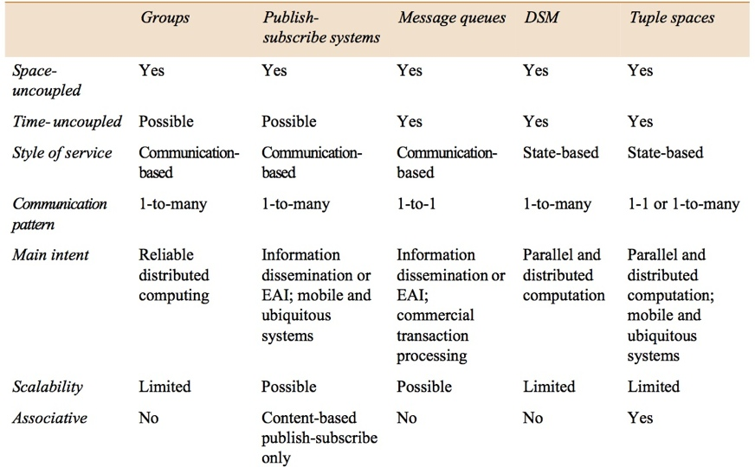
Figure 6.27
Summary of indirect communication styles
Instructor’s Guide for Coulouris, Dollimore and Kindberg Distributed Systems: Concepts and Design Edn. 4
© Pearson Education 2005

